Slide 1

ISocial
Mobile Application Development
by Yusuf Halim

Slide 2
What does the App offer:
Google and Facebook users sign in.
Posting, commenting, and following users.
Sharing App posts to Facebook accounts.
Reporting a bug and/or an inappropriate post.

Slide 3
Planning Process:
Write down
Write down the App features, Design, and Colors.
Estimate
Estimate the time needed to complete the App.
Start
Start designing the UI and Logo.
Finish
Start coding the App functions and add user info to Firebase Database.

Slide 4
Write Down:
Add Image of your work here!

Slide 5

Estimate:
Calculated how many pages the App will have.
Calculate how many hours after school and assignments will be available.
Start estimating how much code to write per day.
Finish by sitting a goal to finish all coding in one month.

Slide 6
Start Designing:
Get the design planning from the raw written data.
Create the pages needed for the App.
Add UI widgets.
Import all colors needed.
Design the Logo based on App appearance and colors.

Slide 7

Put the App to Function:
Establish Firebase database environment.
Add all libraries and SDKs needed.
Put App widgets to function properly.

Slide 8
Finish:
Send app to beta users for testing.
Solve any errors or bugs within the app.
Get feedback from users.
Finish the readme, screenshots, and documentation.
Upload the App package to GitHub.

Slide 9
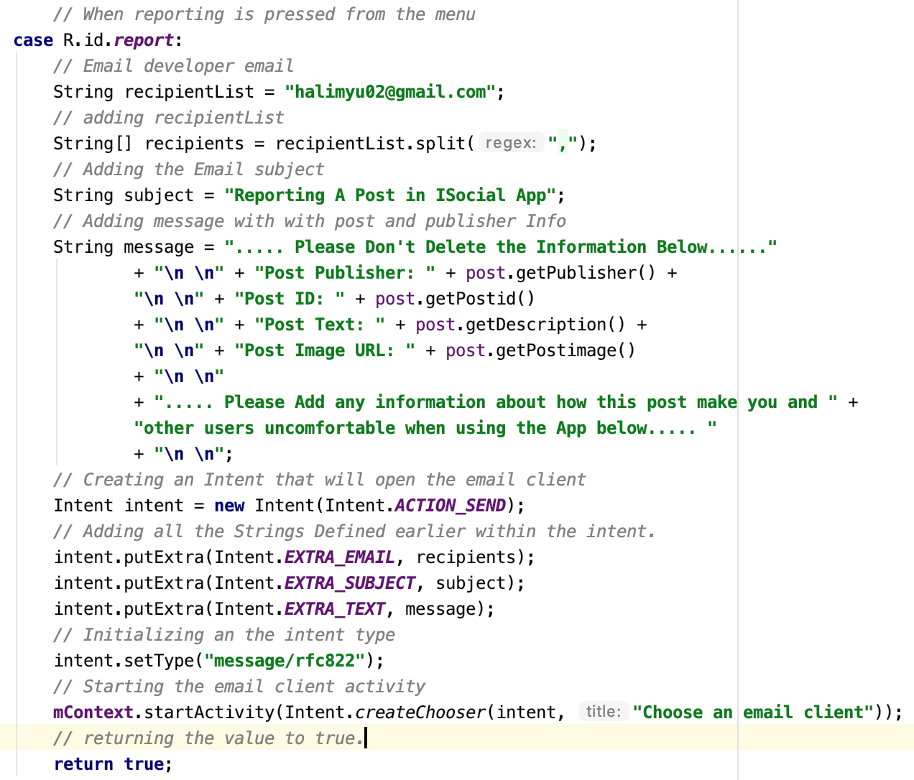
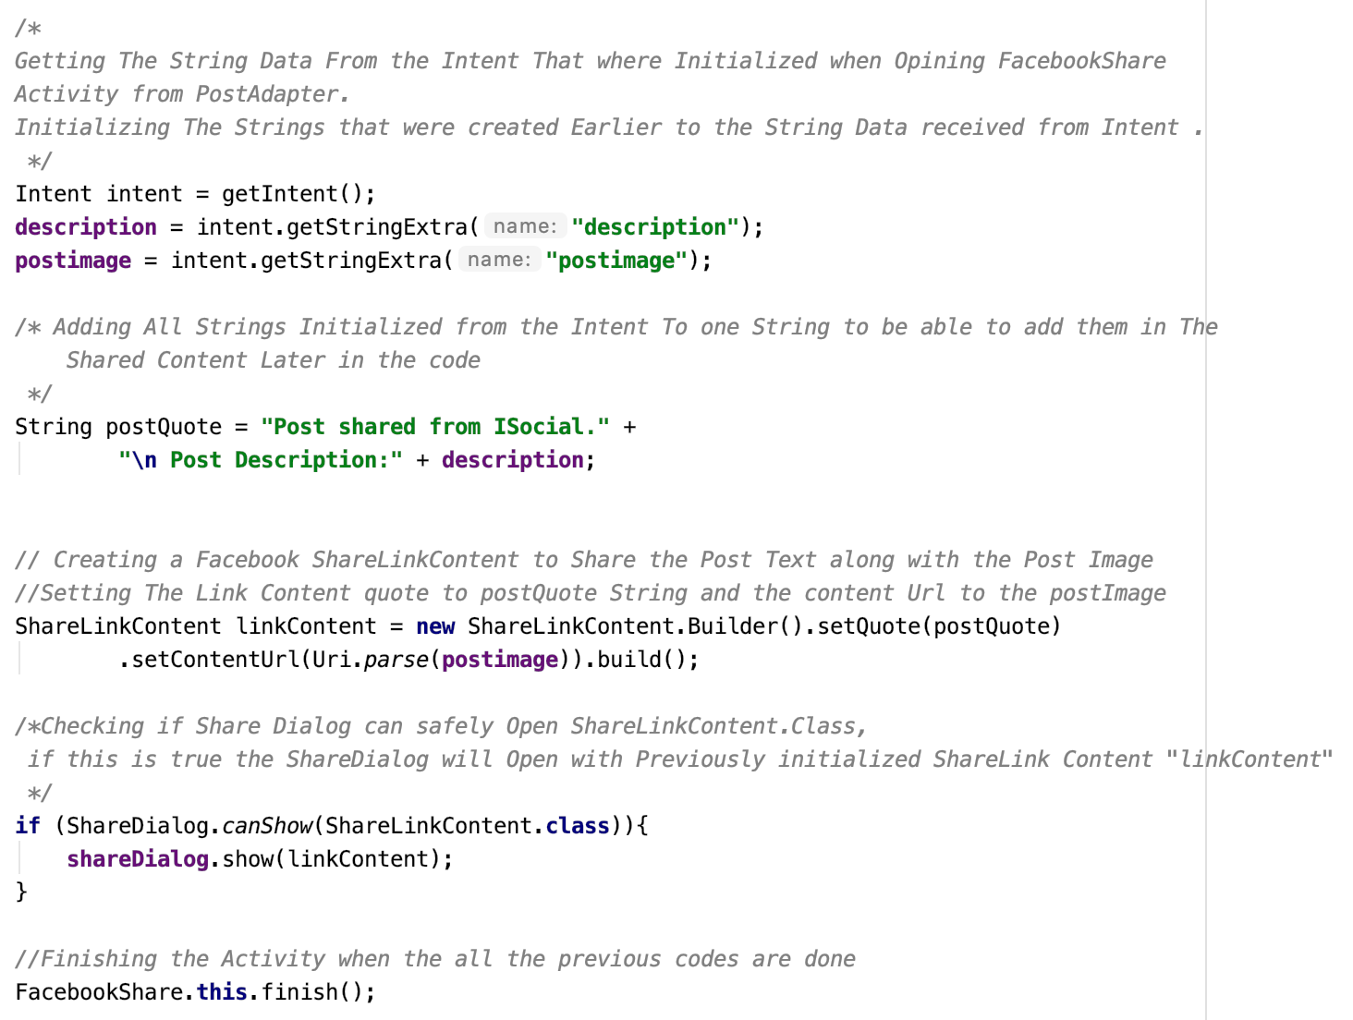
Source code:

Slide 10
Compatibility and App Package:
The App is compatible to almost 73% of android users.
The App Package can be opened using different IDE’s including Visual Studio and Eclipse.

Slide 11
Copyrights:
The App is using 3 libraries and 3 SDKs that are open source and doesn’t violate copyrights.
The app doesn’t use any copyrighted materials.
All researches were done on used libraries before using it in the App to insure they don’t violate copyrights.

Slide 12
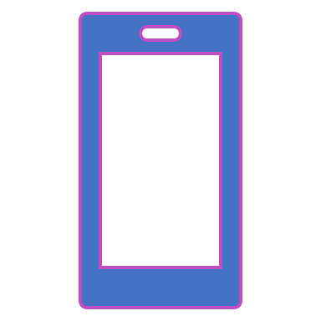
App Demonstration

